Slide 1
Diagnose for Alzheimer’s Disease and Parkinson’s Disease based on MRI brain images
Team 11
Yong-Deok Yun, Eun-Ho Lee, Bo-Young Lim
June 14, 2017

Slide 2
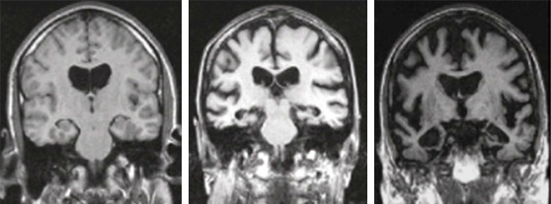
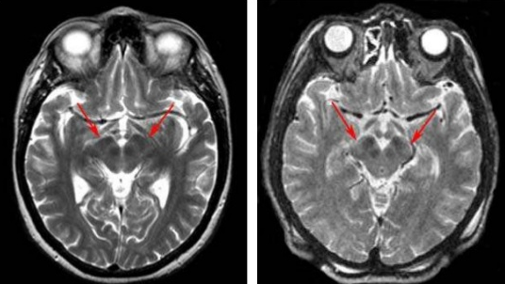
Introduction
Goal
Diagnose for Alzheimer’s Disease and Parkinson’s Disease based on MRI brain images
Alzheimer’s Disease (AD)
Type of dementia that causes memory,
thinking and behavior of problems
Diagnosis
Brain imaging (e.g. MRI, CT, PET)
Genetic testing, neurological exam
Mini-Mental State Examination (MMSE)
Parkinson’s Disease (PD)
Neurodegenerative disease with
symptoms of chronic and progressive
movement disorders
Diagnosis
Brain imaging (e.g. MRI, CT, PET)
Blood test
Neurological examination
MRI scan of AD patient
MRI scan of PD patient

Slide 3
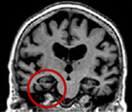
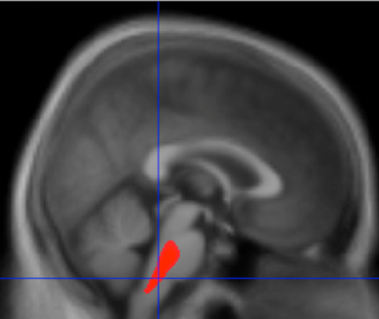
Introduction (Cont.)
Motivations
Cure the disease completely is impossible
Because the damaged brain function can not be completely restored
There is no clinical method that identify AD and PD in a single test
Clinical method that identify AD and PD in a single test is necessary for early diagnosis
Hypothesis
Diagnosis of AD and PD with MRI images is possible
Because damage area of brain is different, features are evident for classifying with MRI images
The MRI image of a Alzheimer’s disease patient
[NIH]
The MRI image of a Parkinson’s disease patient
[Jubault et al., 2009]

Slide 4
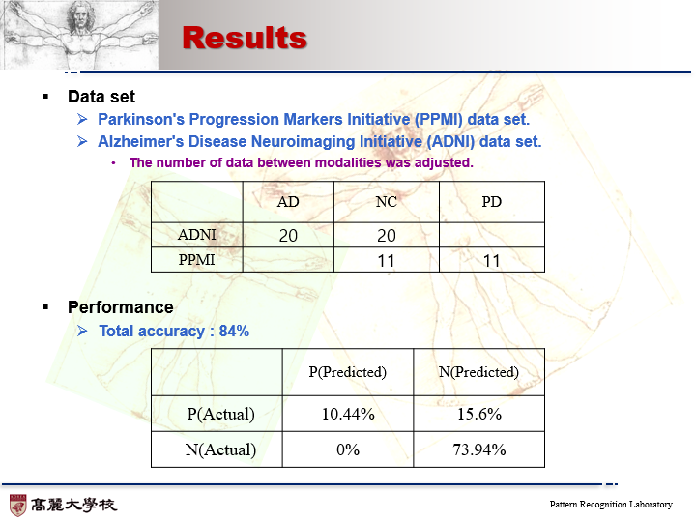
Results
Data set
Parkinson's Progression Markers Initiative (PPMI) data set.
Alzheimer's Disease Neuroimaging Initiative (ADNI) data set.
The number of data between modalities was adjusted.
Performance
Total accuracy : 84%
 | AD | NC | PD
ADNI | 20 | 20
PPMI |  | 11 | 11
 | P(Predicted) | N(Predicted)
P(Actual) | 10.44% | 15.6%
N(Actual) | 0% | 73.94%

Slide 5
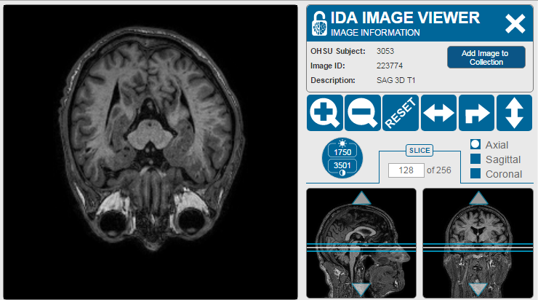
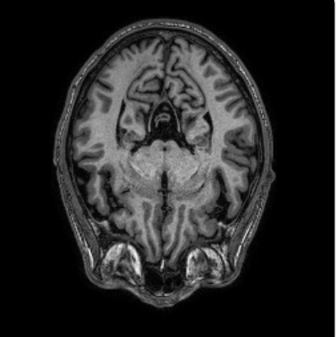
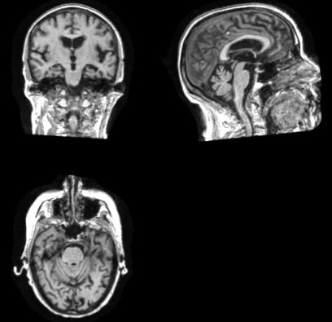
Methods (1/3)
Dataset
Patients who have advanced disease and normal people are compared
First groups are MRI brain images of Parkinson's and Alzheimer’s
Second groups are MRI brain images of normal people
MRI brain images of Parkinson's
The dataset of Parkinson’s Progression Markers Initiative (PPMI)
11 PD, 11 NC
MRI brain images of Alzheimer’s
The dataset of Alzheimer’s Disease Neuroimaging Initiative (ADNI)
20 AD, 20 NC
Control person MRI images
Parkinson’s MRI images
Alzheimer’s MRI images

Slide 6
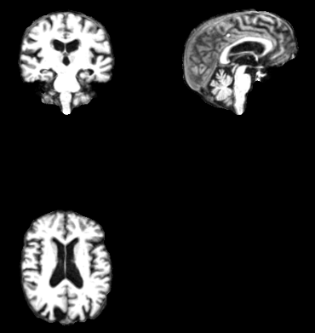
Methods (2/3)
Preprocessing
To extract only brain region, process of automated segmentation of MRI images and surface is essential
Freesurfer tool
The tool is construct model of the boundary between white matter and cortical gray matter as well as the pial surface
Feature extraction
Convolutional Neural Network (CNN) commonly used in medical imaging
3D CNN can better model the 3D spatial information due to use of 3D convolution operations [G Carneiroet al., 2016 ]
3D CNN can solve the discontinuity problem across slices, which are suffered by 2D CNN
MRI image before preprocessing
MRI image after preprocessing

Slide 7
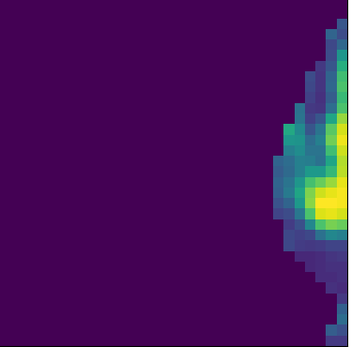
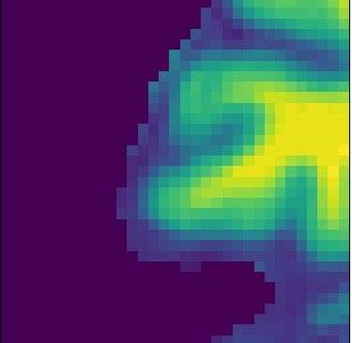
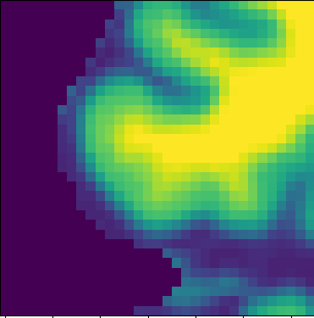
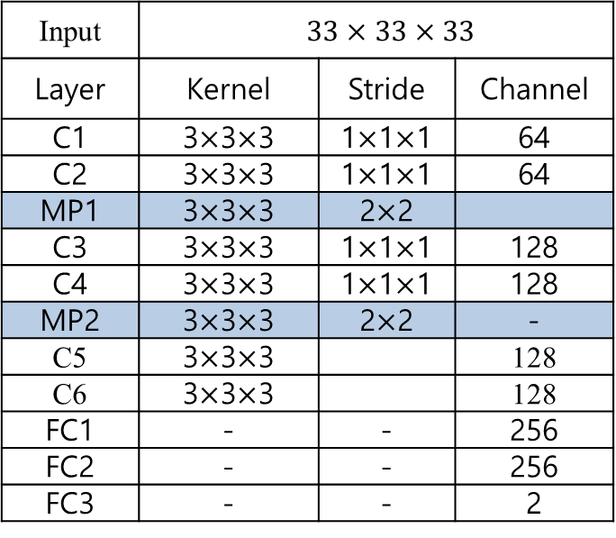
Methods (3/3)
Patch Extraction
We extracted a patch of size 33 * 33 * 33 from a 256 * 256 * 256 original image in 10 steps.
If all values in the patch are 0, they are removed.
3D CNN structure
Input | $$33×33×33$$
Layer | Kernel | Stride | Channel
C1 | 3$×$3$×$3 | 1$×$1$×$1 | 64
C2 | 3$×$3$×$3 | 1$×$1$×$1 | 64
MP1 | 3$×$3$×$3 | 2$×$2
C3 | 3$×$3$×$3 | 1$×$1$×$1 | 128
C4 | 3$×$3$×$3 | 1$×$1$×$1 | 128
MP2 | 3$×$3$×$3 | 2$×$2 | -
C5 | 3$×$3$×$3 |  | 128
C6 | 3$×$3$×$3 |  | 128
FC1 | - | - | 256
FC2 | - | - | 256
FC3 | - | - | 2
ex) Extracted patch

Slide 8
Discussions
Result analysis
Modality of data
Because of different modality about data from ADNI and PPMI, It may affect the result
Optimal parameter setting
Learning rate, number of layers
Discussions
Classify Parkinson’s disease and Alzheimer’s disease based on single model
Diagnosis of senile brain disease with one model is possible by classifying Parkinson’s and Alzheimer’s
Performance improvements

Slide 9
Reference
Reference
F. Pasquier, “Early diagnosis of dementia: neurophychology,” Journal of Neurology, Vol. 246, No. 1, 1999, pp. 6-15
J. Jankovic, “Parkinson’s disease clinical features and diagnosis,” Journal of Neurology, Neurosurgery& Psychiatry, Vol. 79, No. 4, 2007, pp. 368-376
CJL Heron, SL Wright, TR Melzer, "Comparing cerebral perfusion in Alzheimer's disease and Parkinson's disease dementia: an ASL-MRI study." Journal of Cerebral Blood Flow & Metabolism, 2014, pp. 964-970
G. Carneiro, D. Mateus, L. Peter, A. Bradley, J. M. R. Tavares, “Deep Learning and Data Labeling for Medical Applications.”, 2016

